Slide 1
On The Feedback Channel for MIMO Beamforming
Shu Wang

Slide 2
Introduction
MIMO brings an additional dimension and new challenges into next generation wireless system design.
With perfect knowledge, the MIMO spectral efficiency can be linearly increasing with the degree of freedom in space domain.
However, the FL-Tx channel knowledge is
  estimated by FL-Rx through pilots
  quantized by FL-Rx through codebook
  received from FL-Rx through feedback channel
Questions to discuss:
  How FL channel estimation affects MIMO spectral efficiency as well as feedback channel performance?
  How codebook design affect MIMO spectral efficiency?
  What are the impacts on MIMO beamforming related to finite-rate feedback and imperfect channel estimation?

Slide 3
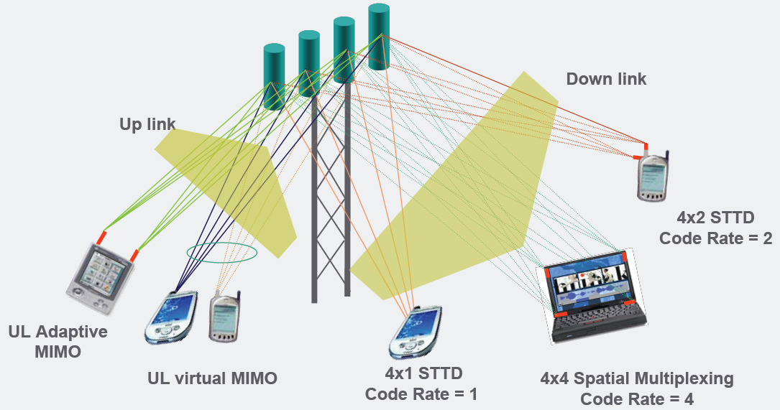
MIMO Communication Scenario
Figure Source: Nortel

Slide 4
MIMO Channel Capacity
Noncoherent MIMO:
  Channel H is unknown to Tx/Rx.
  C = K ( 1 - K / T )log(SNR) + O(1), where K = min{ M, N, T/2 }. [ Zhang and Tse, 2000 ]
Coherent MIMO:
  H is known to Rx only: C = min(M, N) log(SNR) + O(1).
  H is known to Tx/Rx: C = min(M, N) log(SNR) + O(1). [Blankenburg and Wyner, 1970’s; Foschini and Telatar 1995]
In higher SNR region, that transmitter knows the channel may not help much in terms of achievable channel capacity.
However, CQI at Tx can help simplify receiver design.
  Perfect CQI feedback is too expensive. It is not reasonable to feedback M*N complex values
  Finite-rate feedback with channel quantization is the more practical approach.

Slide 5
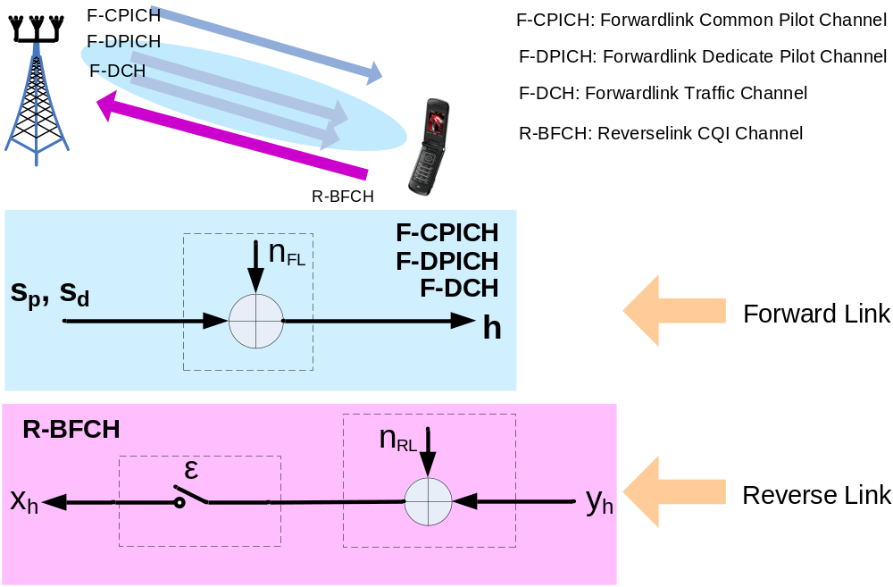
MIMO BF Model with Feedback

Slide 6
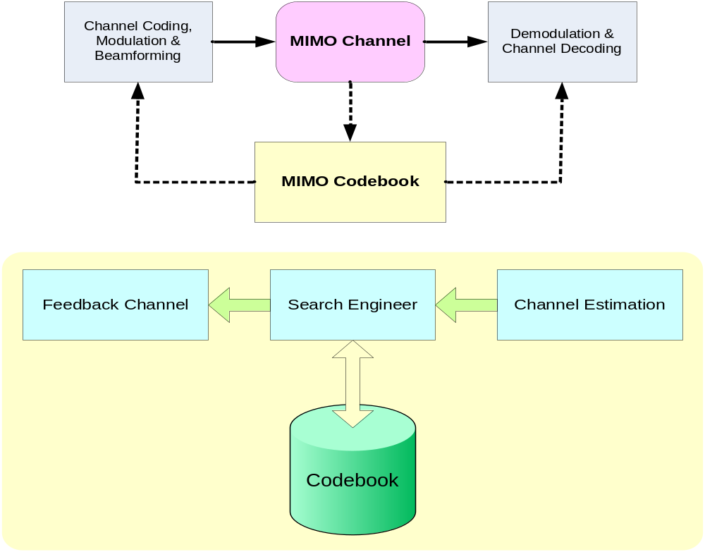
MIMO BF with Limited-Rate Feedback

Slide 7
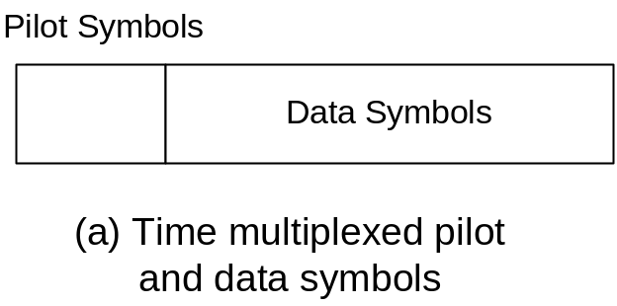
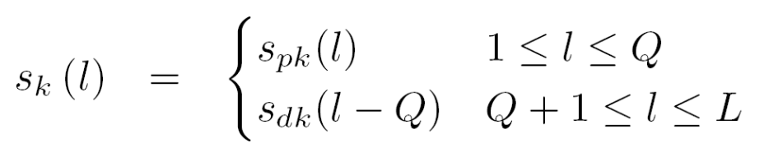
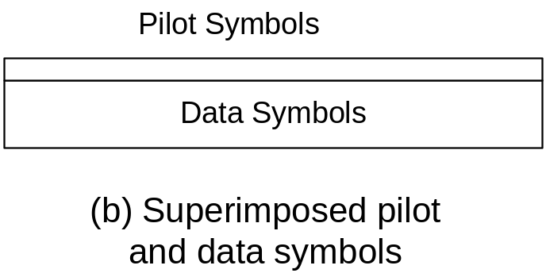
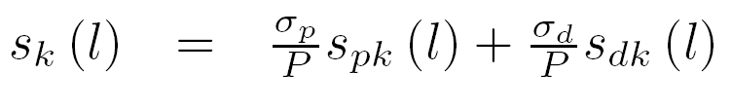
Forwardlink Pilot/Data Channel Design

Slide 8
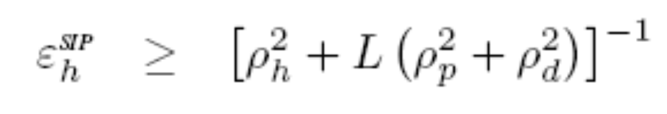

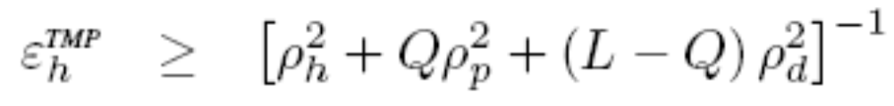
Cramer-Rao Bound on Channel Estimation

Slide 9
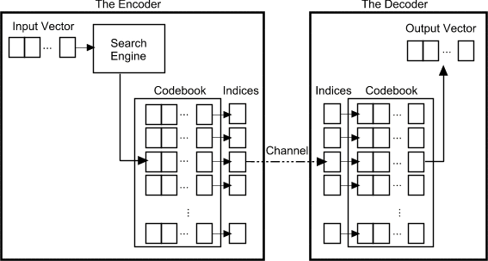
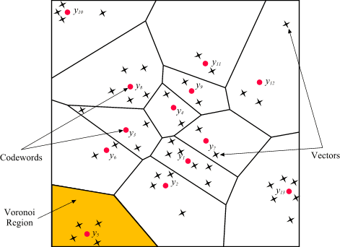
Vector Quantization and Codebook
Generally, the quantizer maps the input vector to the index of a codeword in the codebook. The decode will do the reverse.
  Speech coding. VQ in EVRC, 4GV, AMR, etc.
  Video/Audio Compression. E.g., TwinVQ in MPEG-4
  MIMO CQI Generation. HS-DPCCH in HSDPA Rel. 6, R-CQI in UMB,
Designing a best codebook as well as finding the general boundary of Voronoi cell is NP-hard.

Slide 10
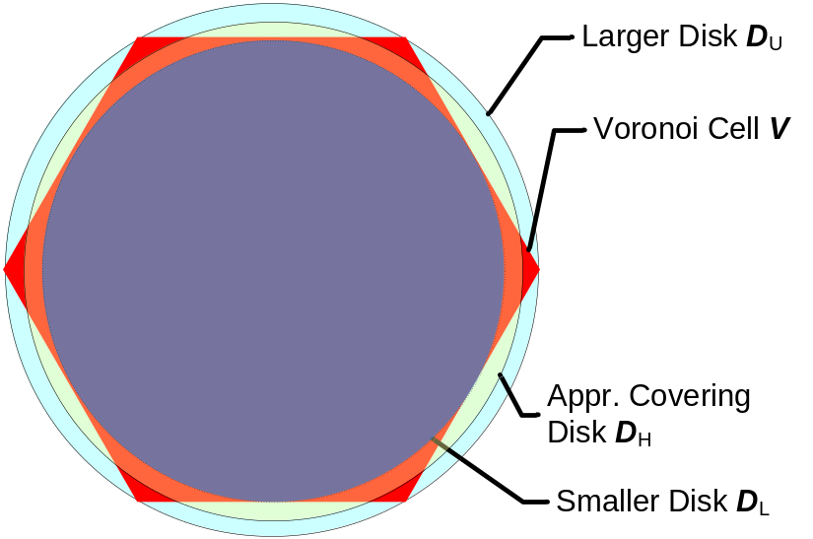
Codebook Voronoi Cell Boundary
Each Voronoi cell can be bounded by a larger disk D_{U} and a smaller disk D_{L} and be approxated by our cover disk D_{H}
But, how close to each other are they?
Upper Bound: finding the bigger disk D_{U} – Disk Covering Problem:
  what is the smallest disk for covering Voronoi cell in a Voronoi diagram?
Lower Bound: finding the smaller disk D_{L} – Sphere Packing Problem:
  What is the largest disk covered by the Voronoi cell in a given Voronoi diagram?

Slide 11
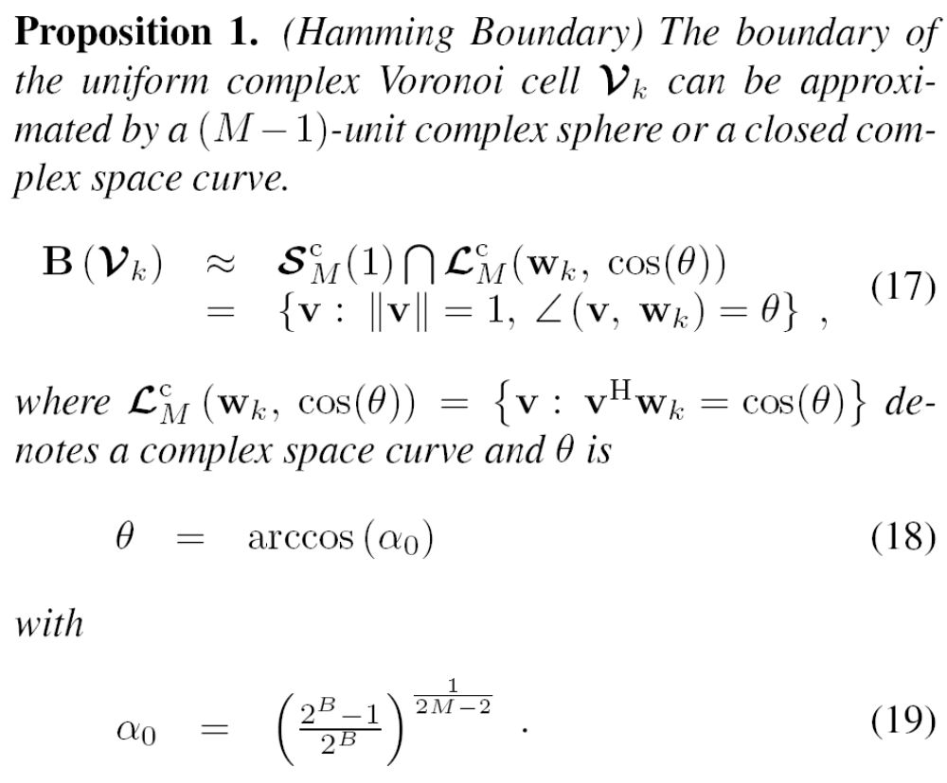
Hamming Bound on Codebook

Slide 12
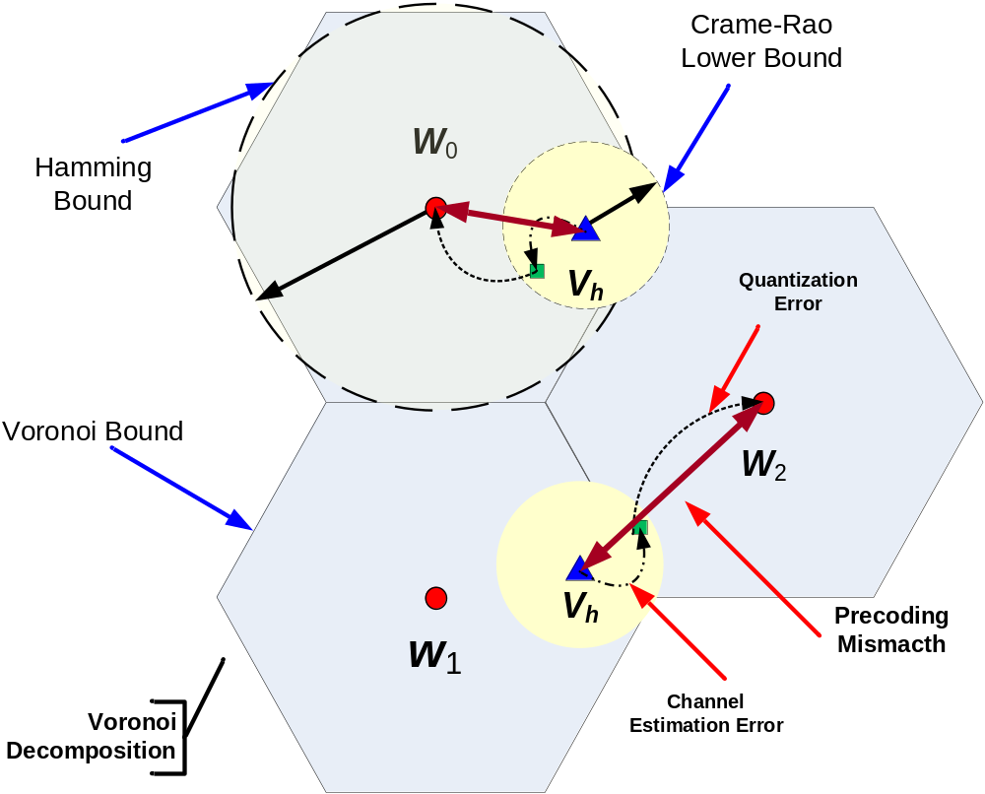
MIMO Precoding Mismatching – A Signal Processing Perspective

Slide 13
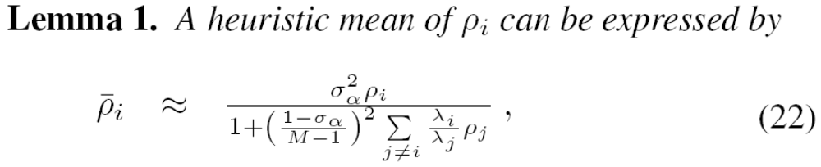
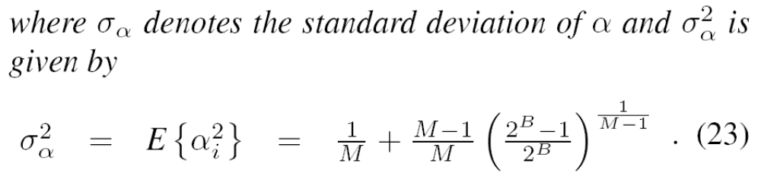
SINR with Precoding Mismatch

Slide 14
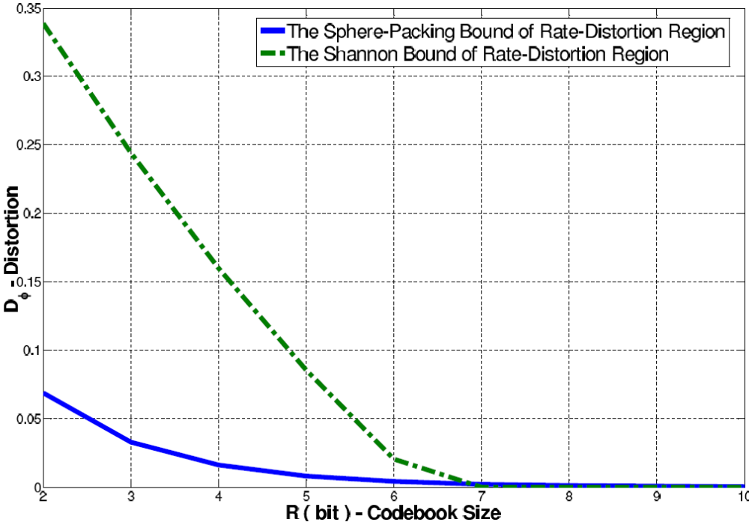

Slide 15
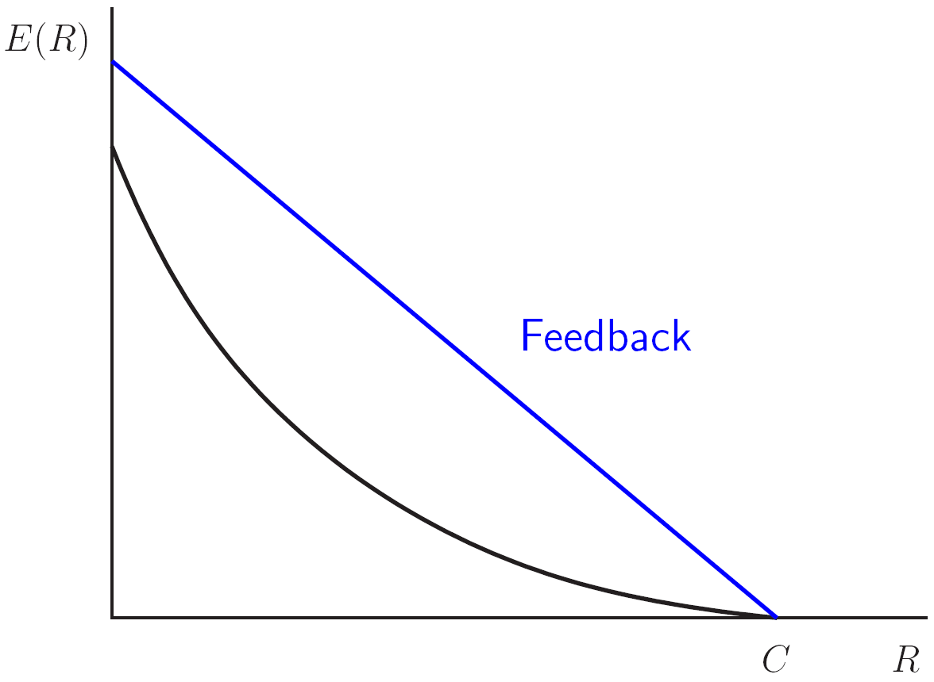
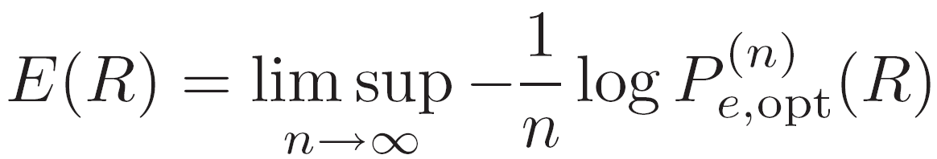
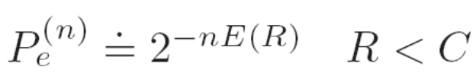
Reliability of Feedback Channel
The error probability of Gaussian Channel decays exponentially with the reliability E(R).
With feedback, high reliability possibly is achievable.

Slide 16
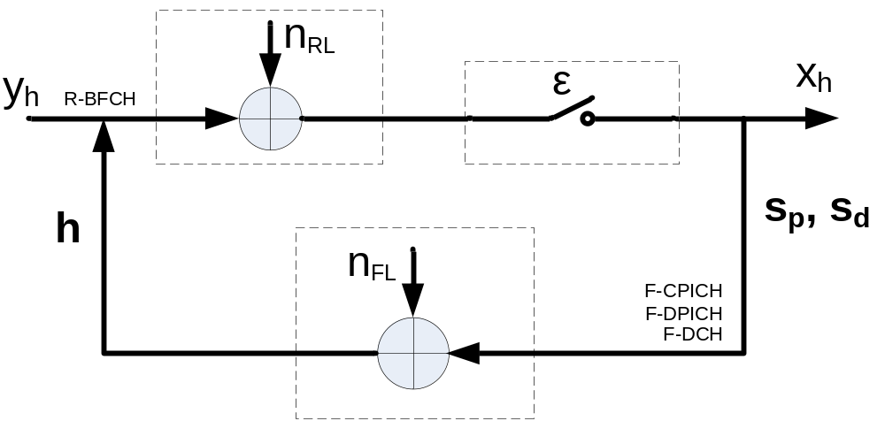
MIMO FB Chan. Model with Chan. Esti.
Feedforward Channel (R-BFCH):
  n_{RL}: CQICH Gaussian Noise
  ε: CQICH erasure rate
Feedback Channel (F-CPICH + F-DPICH + F-DCH)
  n_{RL}: Forwardlink Gaussian Noise

Slide 17
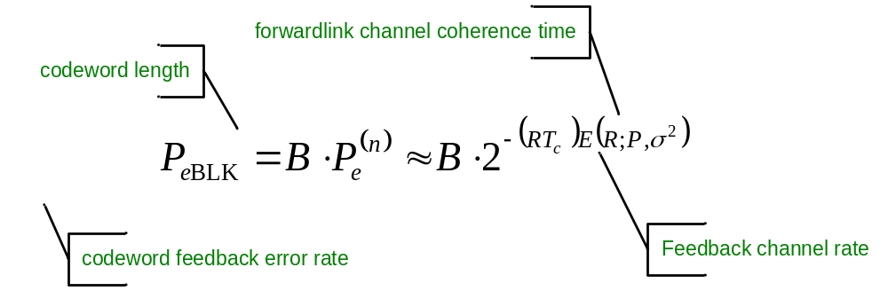
MIMO Precoding Mismatching – A Coding Perspective
What is the P_{eBLK} here? R-BFCH error rate.
For a codebook of size 2^{B}, the relationship between P_{eBLK} and feedback channel reliability roughly is

Slide 18
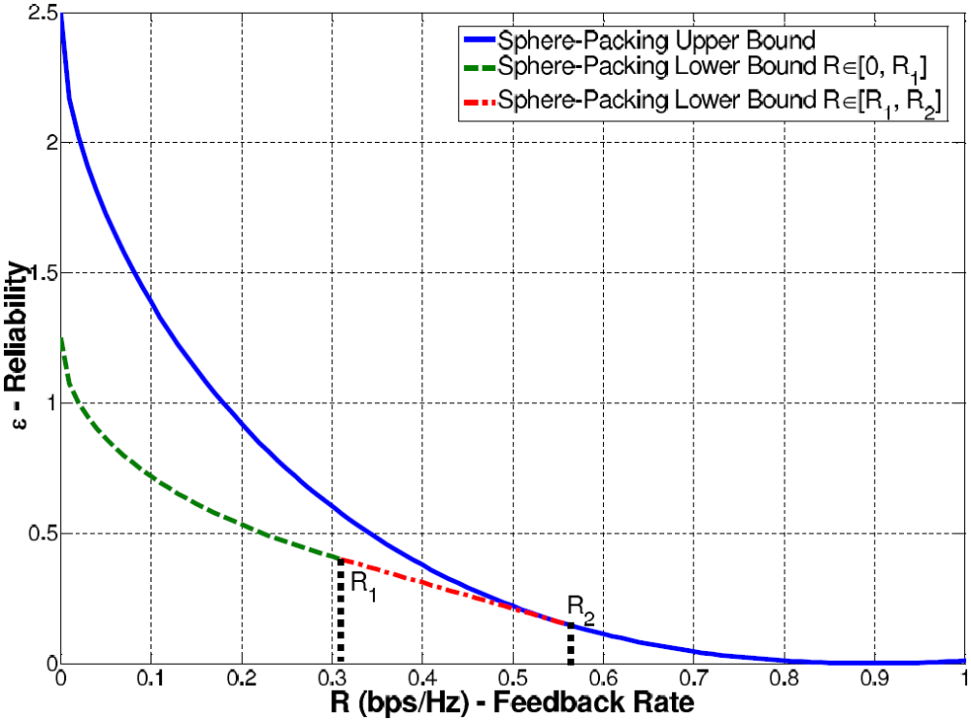

Slide 19
What We learned So far…
MIMO precoding mismatch is a function of
  FL channel estimation: pilot placement
  codebook design: Voronoi cell/boundary
  reliability of feedback channel:
Larger codebook size means less quantization errors, not necessary precoding mismatch.
Both FL channel and RL channel design can affect the achievable rate of R-BFCH.
  When FL with high SNR, the benefits of FL power is similar as RL power (FL/RL coupling)
  When FL with low SNR, RL design is more important than FL.
When R-BFCH is transmitted below the threshold, its reliability is a function of the RL erasure rate, which is decided by reverselink channel fading and buffering.

Slide 20
Let’s Put All Together
So far we have a good understanding of how forwardlink, including Tx-side pilot placement and Rx-channel estimation/quantization affect reverselink feedback channel.
The next question is, how the imperfect channel information received by FL-Tx affects MIMO spectral efficiency and MIMO relay network in general?

Slide 21
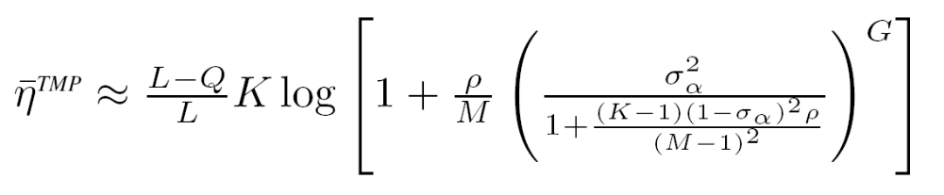
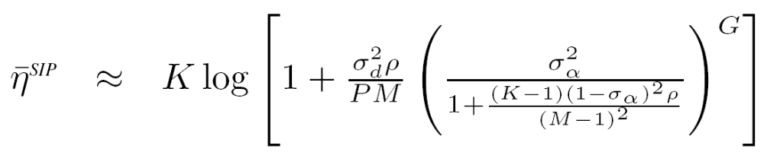
Spectral Efficiency of MIMO Relay Link (1/2)

Slide 22
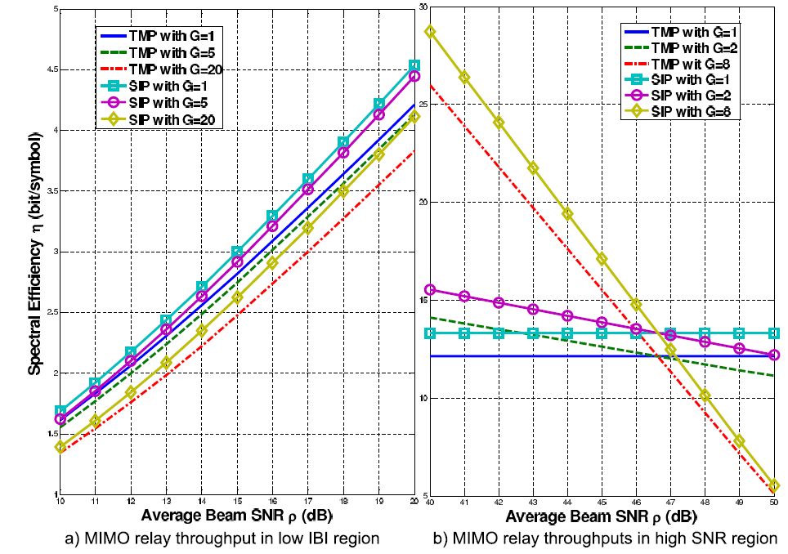
Spectral Efficiency of MIMO Relay Link (2/2)

Slide 23
Observations for MIMO Relay Link
MIMO relay link spectral efficiency is a function of
  Pilot design: TMP/SIP
  Codebook size: larger codebook size is good in general
  The number of hops: more hops may not be good, but..
More hops or higher Tx Power?
  In high SNR region, more Tx power helps more.
  In high IBI region, more hops helps more.

